Slide 1
COMP 1537
Intro to Relational Database Management Systems

Slide 2
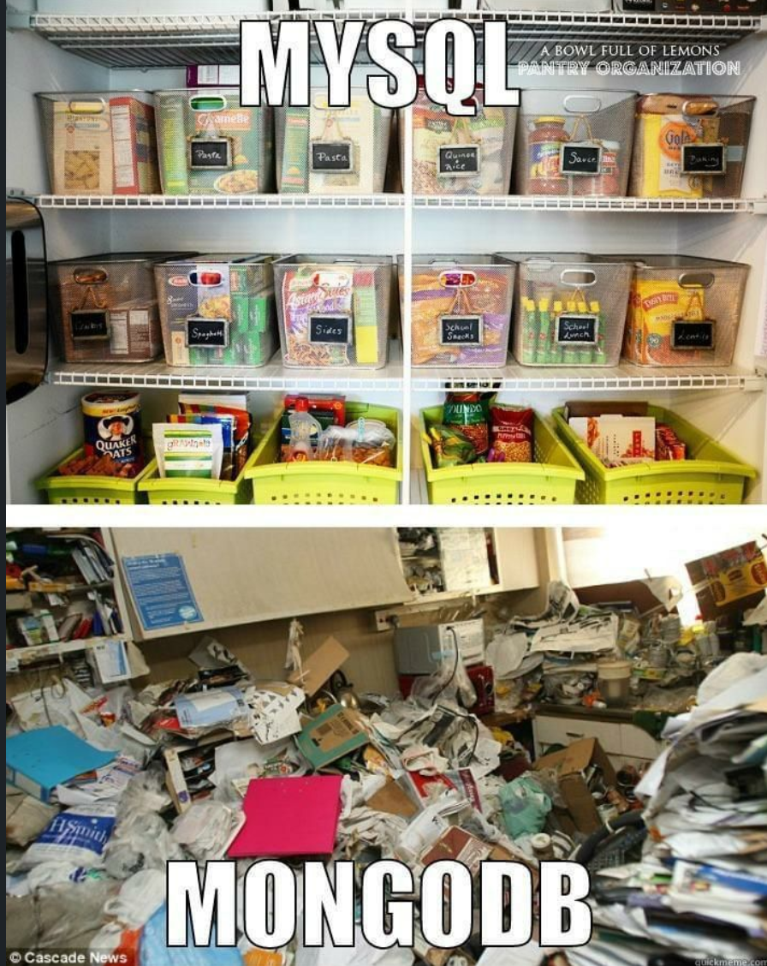
Intro to RDBMS (1/4)
Relational model:
The model used in Relational Database Management Systems (RDBMS)
Table spaces (AKA DBs) have:
Tables which have rows and columns (like a spreadsheet)
Rows (AKA tuples, records) which have
Attributes (AKA columns)
Primary keys (uniquely valued attributes)
For uniquely identifying rows within the table
Foreign keys (uniquely valued attributes)
For uniquely identifying rows within another table

Slide 3
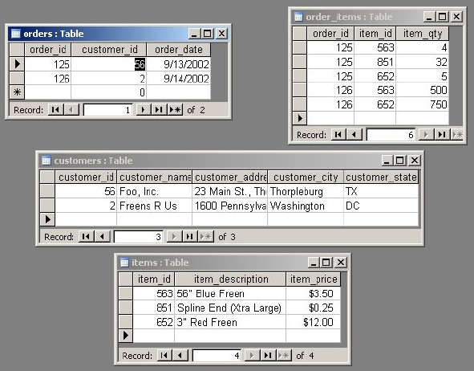
Intro to RDBMS (2/4)
Primary key columns
Foreign key columns

Slide 4
Intro to RDBMS (3/4)
The relational model is good for:
Modeling … relational data
e.g. how many customers, who live in Vancouver purchased a blender model 'XYZ' in the last 6 months and whose purchase was over $500?
Accessing information (different from data), by creating declarative queries
E.g., Structured Query Language (SQL) queries
Storing massive amounts of data and information efficiently
Via an implementation (i.e. RDBMS)
Data mining
Which is using massive data stores to predict trends & behaviors, discovery of unknown/undiscovered patterns/trends

Slide 5
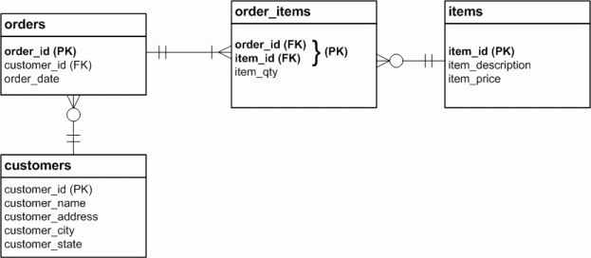
Intro to RDBMS (4/4)
Entity Relationship Diagram (ERD)

Slide 6
How RDBMS Work
Is a server
E.g., Oracle MySQL, Oracle DB, Microsoft SQL Server, etc.
Run in the background and answer calls
Just like a web server
“Speaks” a query language – Structured Query Language (SQL)
Can handle multiple requests, use authentication
Allow for data manipulation
Creating/updating/deleting databases/tables/columns/rows
Very powerful, fast, mature technology

Slide 7
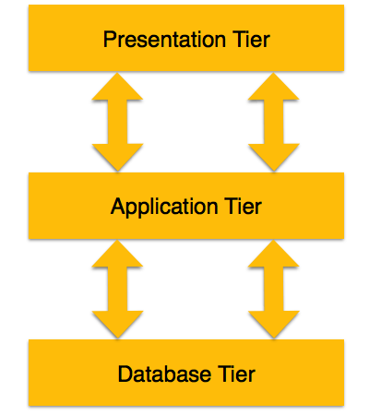
RDBMS in Web
Presentation tier: web browser/native application
E.g., web browser: HTML5, CSS3, JavaScript
Application tier: web server/service
E.g., PHP/Apache
Database tier: RDBMS
E.g., MySQL
Together, these form the standard 3-tierd web architecture
A beginning point for a web service

Slide 8
RDBMS Concepts (1/2)
Entities – person, place, thing (i.e., noun)
Represent real-world or virtual things
E.g., person, transaction
Attributes – a field for a record within a table
E.g., color, age, size, postal code, id
Relationship – logical association mapping multiple entities
E.g., an employee with three dependents, an order with several order items
Row – one or more columns of data storing info for one record
E.g., student data

Slide 9
RDBMS Concepts (2/2)
Primary key – a unique non-null value that identifies a row within a table
Foreign key – a value that identifies a row
In either the current table or another table
Constraints:
Key – in a table, no two records have the same value for a key
Domain – business rules set by a DB designer
E.g., age can only be a positive value between 0 and 128
Referential integrity – a foreign key must reference a primary key
Composite key – a key composed of multiple attributes

Slide 10
Normalization
Normalization: a process designed to:
Organize structured data, eliminate redundancy, eliminate the need to restructure the DB when new data is added
Five levels of normalization:
1st normal form
2nd normal form
3rd normal form
4th normal form
5th normal form
6th normal form
We’re only interested in going to 3rd normal form

Slide 11
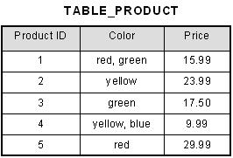
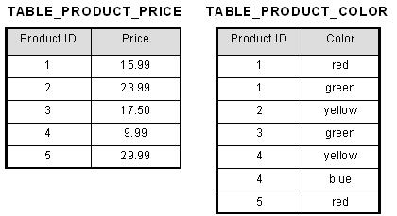
1st Normal Form
No repeating/duplicate fields
Each cell contains a single value
Each record is unique (via primary key)

Slide 12
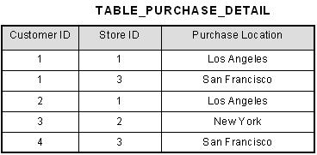
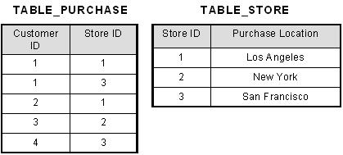
2nd Normal Form
All non-key fields depend on all components of the primary key

Slide 13
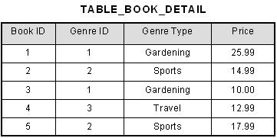
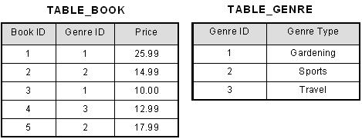
3rd Normal Form
No non-key fields depend upon another

Slide 14
Structured Query Language
SQL has two parts:
Syntax for queries
Syntax for creating the DB: Data Definition Language (DDL)
We need both!
Note: syntax use semicolons at the end of a statement
A statement can flow multiple lines
But ends when you put a semi-colon at the end

Slide 15
Installing MySQL
For both Mac and Windows, download XAMPP
Yes, it has extra servers that we don’t need (e.g, Apache Server, Tomcat, etc.)
But it has a fully configured version of MySQL for us that has all the default values built into it
Set environment variables so that you can access the mysql tool at the console/terminal
Windows (default path): c:\apps\xampp
In cmd, type: mysql –u root -p
Mac OS (default path): /Applications/xampp/xamppfiles/bin
In terminal, type: ./mysql –u root -p

Slide 16
MySQL Commands (1/2)
To start running mysql:
mysql –u root –p
it will request password (type 'root' – without the quotes)
You will now be in MySQL and be able to type commands
To quit mysql:
quit
To put data and/or tables into a database:
mysql -h localhost test < data-and-ddl.sql
where 'test' is the name of the database you want to put data into,
localhost is the name of the server, and;
data-and-ddl.sql is the text file with your SQL code

Slide 17
MySQL Commands (2/2)
To get data and/or tables out of the database and into a text file:
mysqldump -u [user] –p [pass] [DB name] > textfile.txt
To get just tables – no data:
mysqldump -u [user] -p[pass] --no-data [DB name] > textfile.txt
To get just data – no tables:
mysqldump -u [user] -p[pass] --no-create-info [DB name] > textfile.txt

Slide 18
Manipulating Tables and Databases
Showing, creating, editing, deleting databases:
show databases;
create database [db_name];
use [db_name];
drop database [db_name];
Showing, describing, dropping (i.e., deleting) tables:
show tables;
describe [table_name];
drop table [table_name];
rename table [old_name] to [new_name];

Slide 19
Creating/Altering Tables, DDL Statements
Creating a table:
create statement (see examples)
Creates a new table inside of a database
Altering a table
alter statement (see examples)
Alters an existing table (e.g., add a row, change a row's type, remove a row)
Be careful with ALTER
you will remove data – so remember to back up your work before performing an alter of a table

Slide 20
Inserts, Queries
To insert rows into a table in a database:
insert statement (see examples)
puts new rows into a table (i.e., a write operation)
To select rows from a table in a database:
select statement (see examples)
selects rows from a table (i.e., a read operation)

Slide 21
Things to Remember
Terminal, start MySQL
Once in MySQL in terminal, all commands are for MySQL
not terminal
To quit MySQL, type 'quit'
Database tables and their data can be imported and exported
Rows in tables can be selected and inserted into
via input at the terminal
Next week we shall see how to do this programmatically with PHP!

Slide 22
Resources
Optional Readings (cont'd):
http://en.wikipedia.org/wiki/Data_definition_language
http://www.w3schools.com/sql/sql_update.asp
http://www.w3schools.com/sql/sql_insert.asp
http://www.w3schools.com/sql/sql_select.asp
https://www.quackit.com/database/tutorial/

